Slide 1


PANIMALAR ENGINEERING COLLEGE
Department of Computer Science and Engineering
Deduplication in Cloud Computing Improvise Efficiency Towards Potential Practical Usage
Team members:
S.Vignesh (211417104299)
R.Sharan (211417104255)
J.Shachin Karthik (211417104250)
Guide:
Mr.G.Senthil Kumar, Asst.Professor

Slide 2
Introduction
Cloud storage as one of the most important services of cloud computing. Data ownership proof is an essential process of data deduplication, especially for encrypted data. But this scheme does not provide flexible deduplication control across multiple Cloud Service Providers (CSPs).
In this paper, they propose a multiple cloud service provider (CSPs) in which the data owner will upload the file and the hash MD5 algorithm is used to check data duplication during data storage at the cloud. CSPs.
It can achieve data deduplication and access control with different security requirements. And also they have proposed a scheme called Provable Ownership of the File(POF). The result it is security, effectiveness and efficiency towards data storage management.

Slide 3
Literature Survey
S.NO | TITLE/AUTHOR | METHOD/ TECHNIQUE | MERITS | PROBLEMS
1 2 | Resource allocation and scheduling in cloud computing, E. Elghoneimy, O. Bouhali and H. Alnuweiri Client-side deduplication using whole file hashing J. Bethencourt, A. Sahai | Capacity allocation, load balancing and energy consumption optimization. Hashing process is performed at the client | Ideal resource allocation identifies the duplication by comparing with the existing hash values in Metadata Server | Focus on only task time span and energy. More time consuming than the traditional systems

Slide 4
Problem Statement
The major impact of existing deduplication in cloud computing conducts redundant files with less data storage and security.
This problem can be proposed using hash value to check redundant files by comparing existing hash value when a file is uploaded into cloud by using MD5 Hash key Algorithm.
MD5 Algorithm is used in deduplication technique to remove redundant data and decrease the space in cloud storage.

Slide 5
Software / Hardware used
Software and tools used:
Windows 7 and above
JDK 1.8
J2EE
Tomcat 7.0
MySQL
Hardware used:
Processor : intel i3
Storage : 1TB
RAM : 4 GB
OS : windows

Slide 6
System Architecture
Data Storage
Cloud Storage
Service
Registration
Login
File Upload
Same File
Access polices
Download Request
Block with signature
Deduplication Check (CSV)
Cipher Text
POF-CSV
Security Question
Reference
Verification

Slide 7
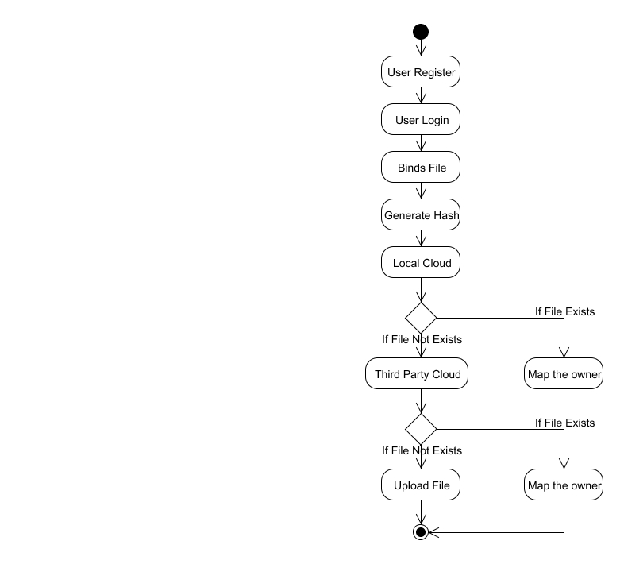
System Design
1. FLOW DIAGRAM

Slide 8
2. DATA FLOW DIAGRAM
Level 0:
User
Register
Admin
Verify User
Level 1:
Approved User
Login
Binds File
Generate Hash

Slide 9
Level 2:
User
File Binding
Generate Hash
Local Server
Checks for File Existence
Third Party Server
Level 3:
User
Binds File
Local Server
If File already exists
Map the owner
Third Party Server
If File not exists
Upload the File

Slide 10
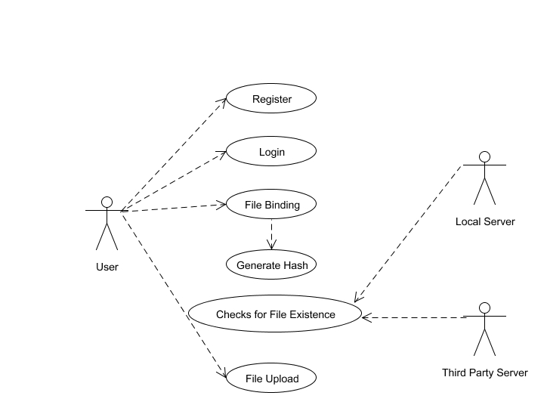
3. USE CASE DIAGRAM

Slide 11
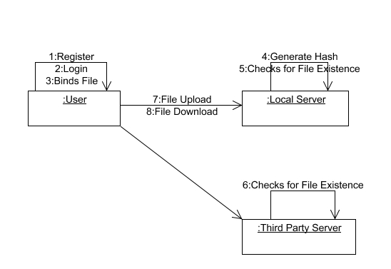
4.COLLABORATION DIAGRAM

Slide 12
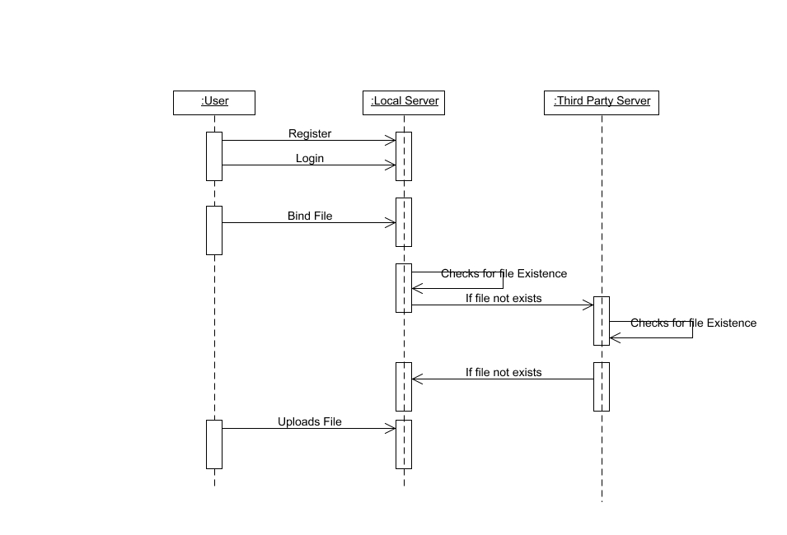
5. SEQUENCE DIAGRAM

Slide 13
Modules
Cloud User Authentication.
File Upload and Comparison.
Set Access Policy for File.
File Download Request and Handling.

Slide 14
1.Cloud User Authentication
Owner has an initial level Registration Process in Cloud Service Provider(CSP).
The users provide their own personal information for this process. The server in turn stores the information in its database.
Then they have the Login process for the further access in cloud service Provider.

Slide 15
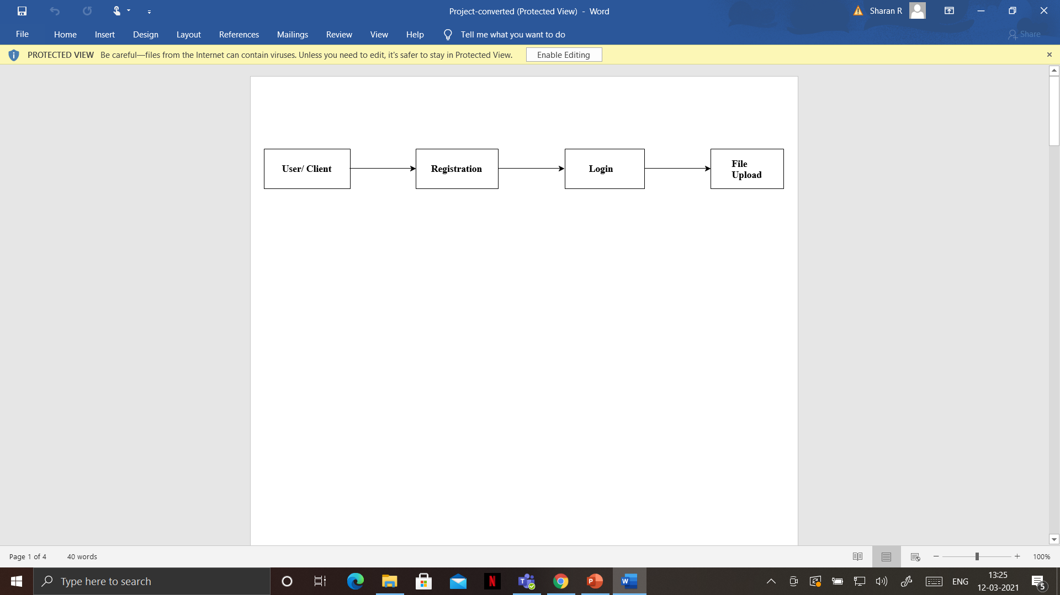
Cloud User Authentication Flowchart

Slide 16
2.File Upload and Comparison
In this module, the data Owner create their account under the Public cloud and upload the file in cloud storage. Here the Provable Ownership of the file(POF) scheme is proposed.
While uploading the file by data owner, the hash key is generated based on MD5 algorithm.
The hash key is unique for all the upload files. But if the same file is upload by the other data Owner it will not allow the file to upload rather then it will replace the reference id through Mapping of index. It also check the file for physical present or not by both the data Owner.

Slide 17
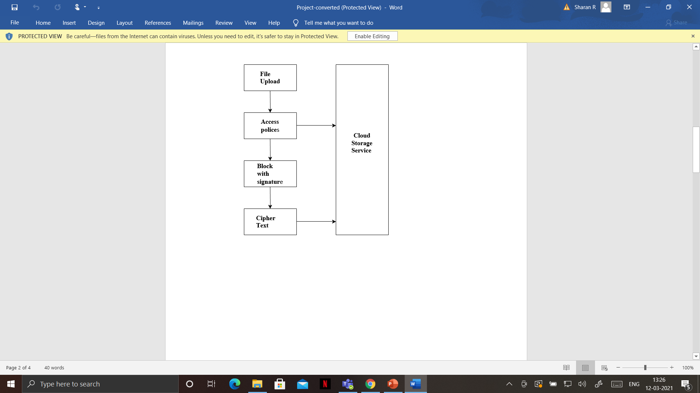
File Upload and Comparison Flowchart

Slide 18
3.Set Access Policy for File
In this module User will chooses the file and uploads to Storage where the HDFS storage system .In the system will generate a signature in particular file and then split into multiple block.
Each block will be generate signature with key . In the signature by using MD5 message-digest algorithm is cryptographic hash function producing a 128-bit hash value typically expressed in text format as 32 digit hex value so that files of same are de-duplicated.
After that generate convergent keys for each blocks splitting to store CSV file .like filename, file path, blocks, username, password and block keys.

Slide 19
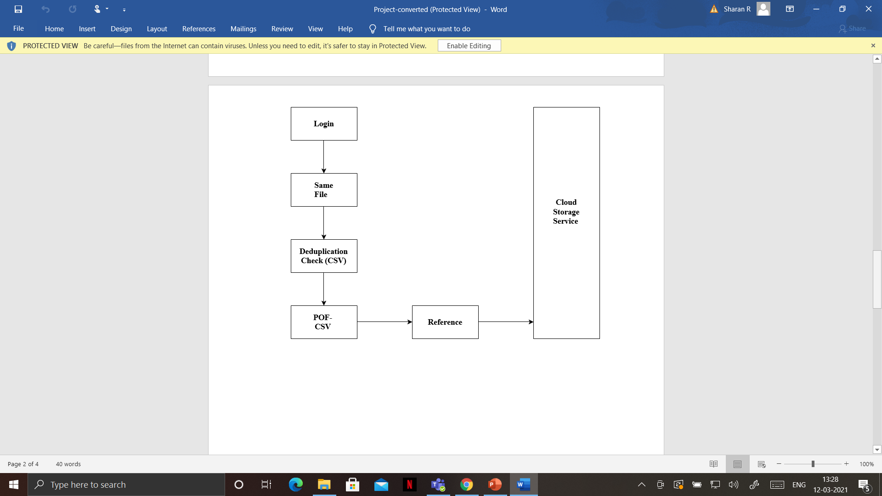
Set Access Policy for File Flowchart

Slide 20
4.File Download Request and Handling
In this module , the data owner will download the file from cloud service provider.
If they do not find the file then they will request to download the file from different Cloud service provider and also check whether the file is present or not
It gives the response to data owner.

Slide 21
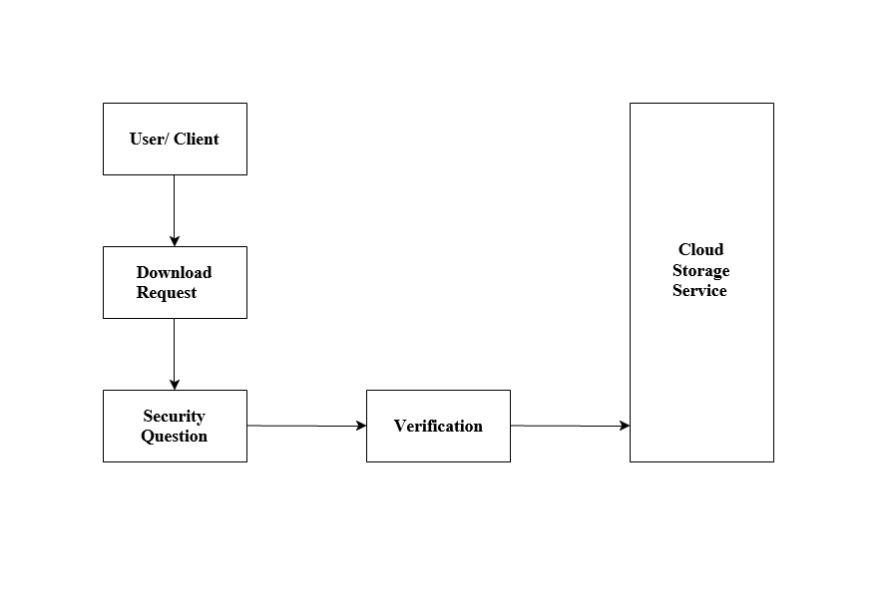
File Download Request and Handling Flowchart

Slide 22
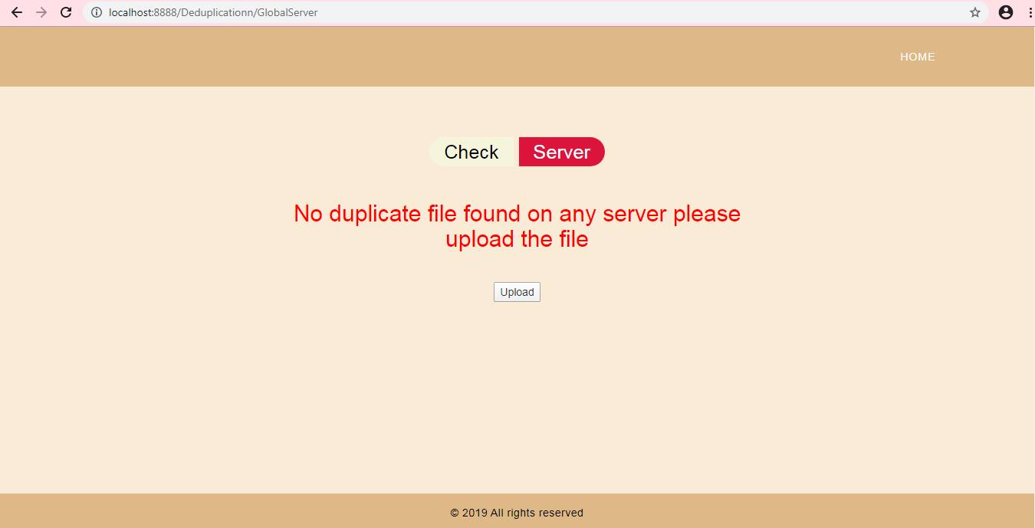
Testing/Performance Analysis
Test case 1:
No duplicate file found on the server when we try to upload a very new file.

Slide 23
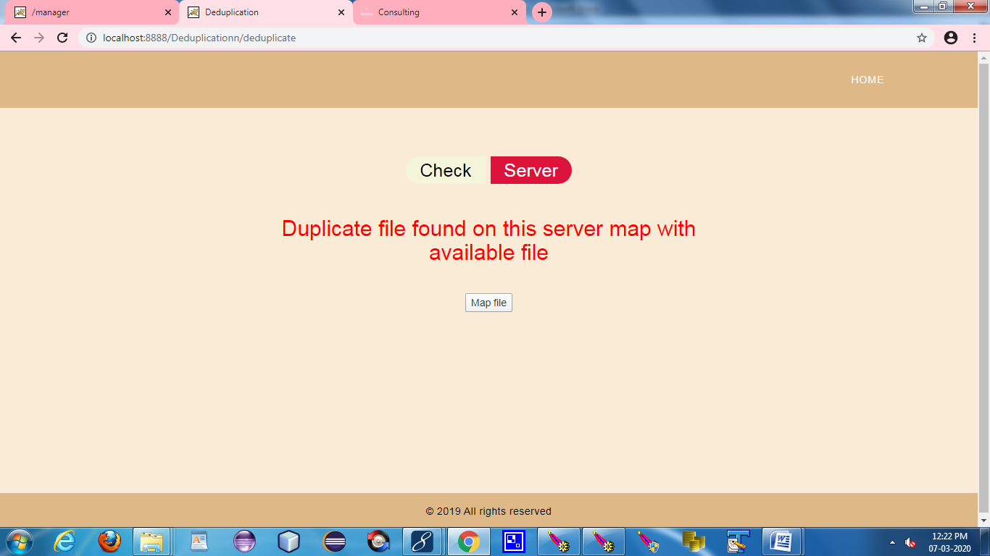
Test case 2:
Duplicate file is found on the server when we try to upload the same file existing in the server and it tries to map the file to the existing file.

Slide 24
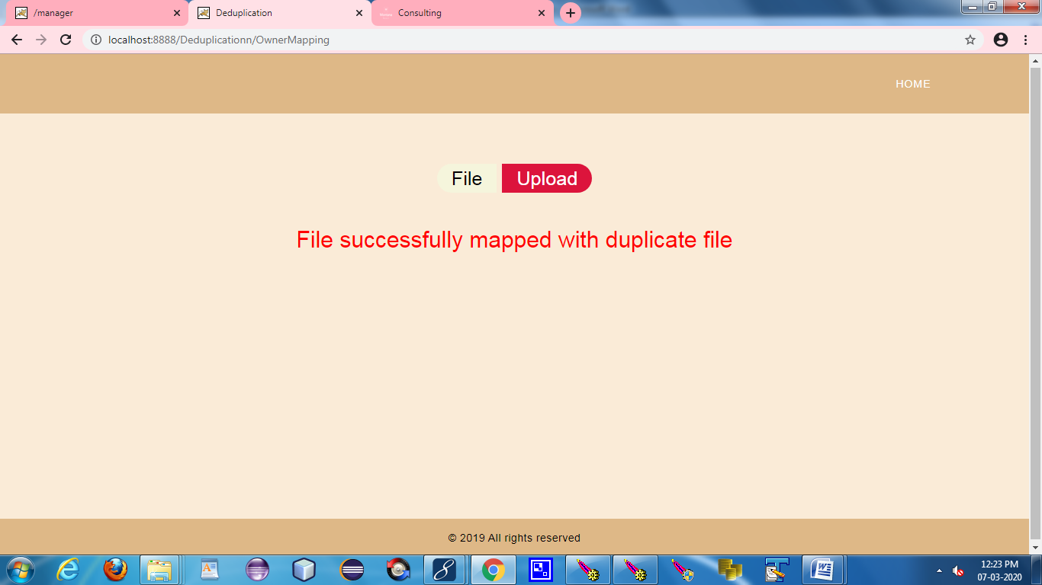
Test case 3:
Once the file duplication is found it is mapped to the existing file.

Slide 25
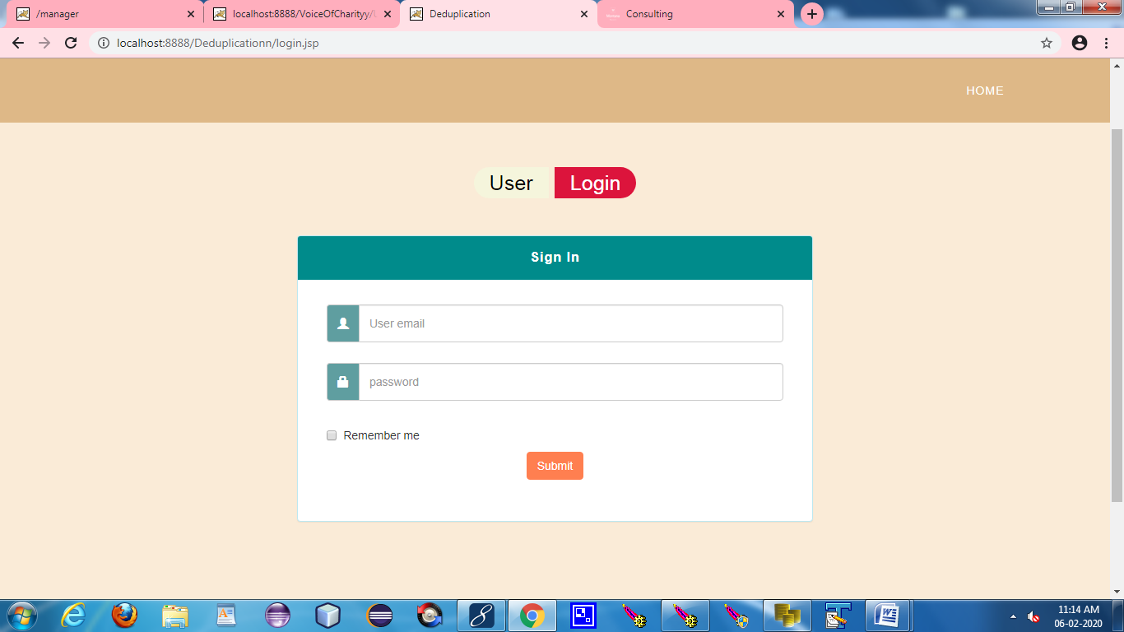
Screen Shots
1.User Login

Slide 26
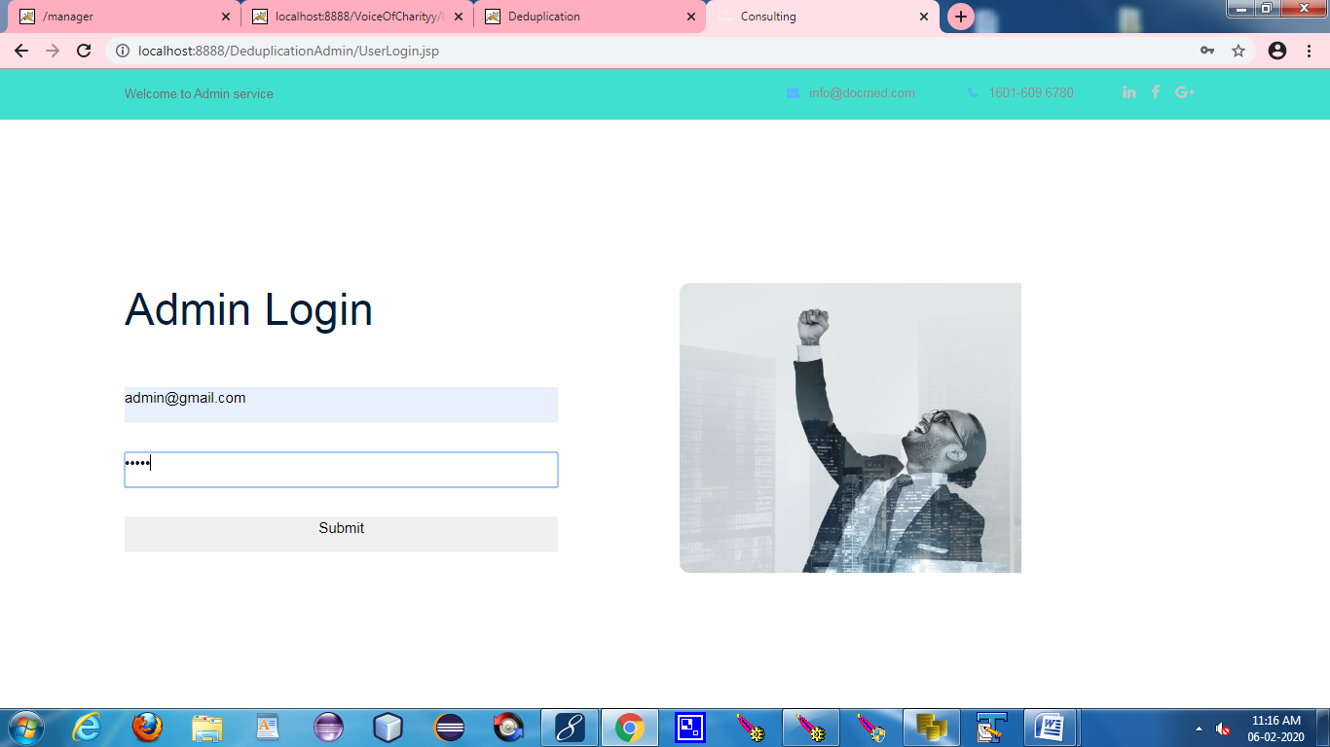
2.Admin Login

Slide 27
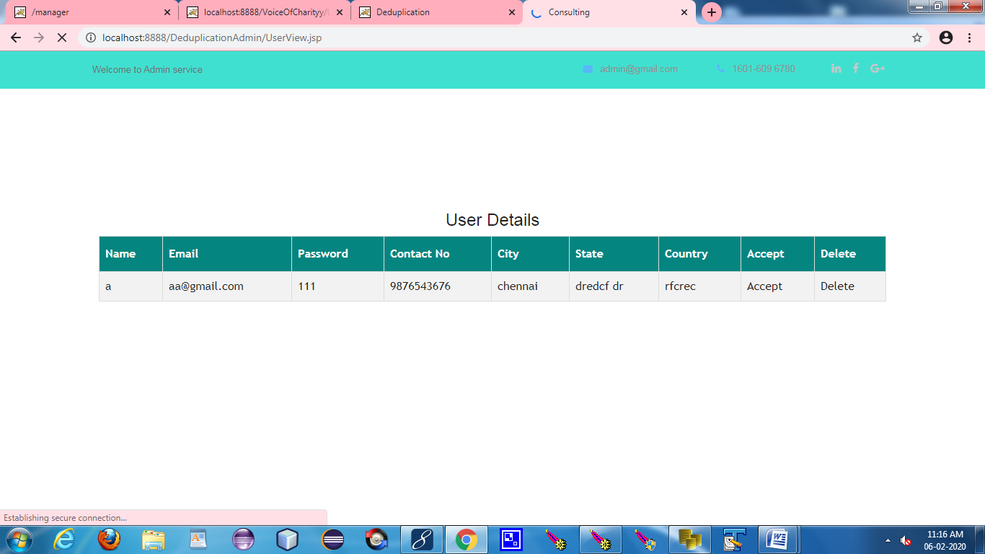
3.Acceptance and Denial

Slide 28
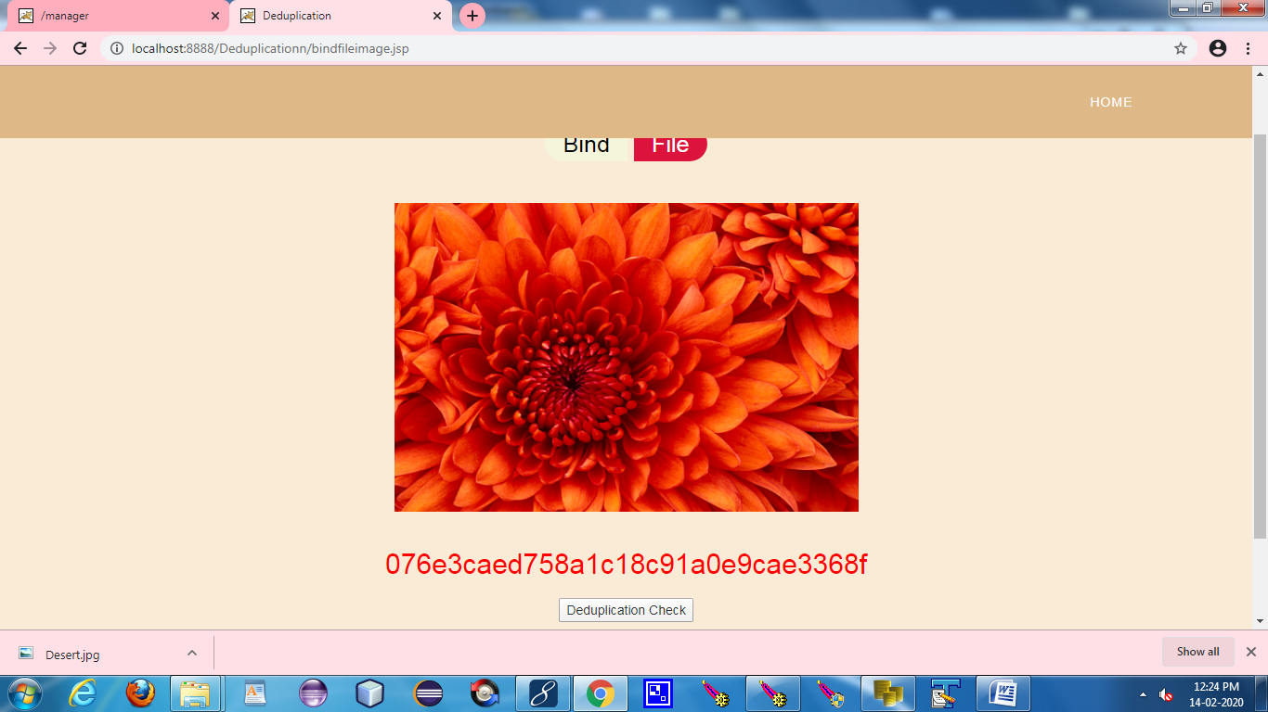
4.Genration Of Hash

Slide 29
Conclusion
Existing methods for locating deduplication in cloud storage were effective in achieving data integrity and storage reliability.
Our system also allows many users to share a single memory space, allowing us to save more space than previous methods. It also protects the user's privacy by verifying their evidence of ownership.
The work can be implemented in a real-time environment to improve the reliability and usability of file auditing by enabling users to authenticate their cloud-based file content without downloading the entire file.

Slide 30
Future Enhancements
As the deduplication of files is done locally ,this can be further expanded and can be done globally which involves high financial supports.
This will improve the efficiency and widespread use of the system.

Slide 31
Reference Paper/ URL
[1] R. Chow, et al., “Controlling data in the cloud: outsourcing computation without outsourcing control,” in Proc. ACM Workshop Cloud Comput. Security., 2009, pp. 85–90.
[2] S. Kamara, and K. Lauter, “Cryptographic cloud storage,” Financ. Crypto. Data Secur., 2010, pp. 136–149.
[3] Q. Liu, C. C. Tan, J. Wu, and G. Wang, “Efficient information retrieval for ranked queries in cost-effective cloud environments,” in Proc. IEEE INFOCOM, 2012, pp. 2581–2585.
[4] M. Kallahalla, E. Riedel, R. Swaminathan, Q. Wang, and K. Fu, “Plutus: scalable secure file sharing on untrusted storage,” in Proc. USENIX Conf. File Storage Technol., 2003, pp. 29–42.
[5] E.-J. Goh, H. Shacham, N. Modadugu, and D. Boneh, “SiRiUS: securing remote untrusted storage,” in Proc. Netw. Distrib. Syst. Secur. Symp., 2003, pp. 131–145.
[6] J. Bethencourt, A. Sahai, and B. Waters, “Ciphertext-policy attribute- based encryption,” in Proc. IEEE Symp. Secur. Privacy, 2007, pp. 321–334.
[7] V. Goyal, O. Pandey, A. Sahai, and B. Waters, “Attribute-based encryption for fine-grained access control of encrypted data,” in Proc. 13th ACM Comput. Commun. Secur., 2006, pp. 89–98.

